Slide 1
Chapter 11
Managing Project Teams

Slide 2
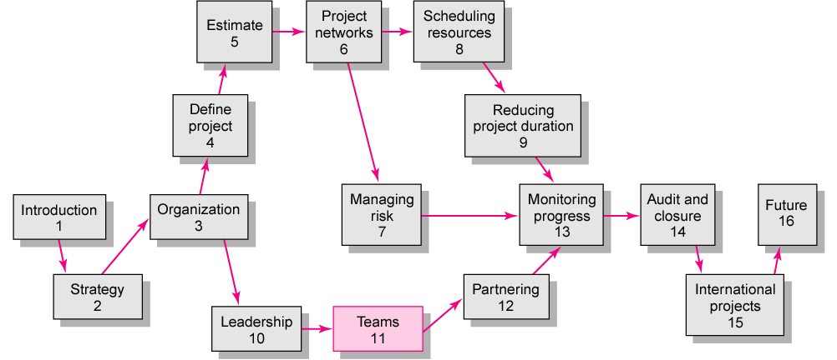

Slide 3
High-Performing Teams
Synergy
  1 + 1 + 1 = 10 (positive synergy)
  1 + 1 + 1 = 2 (negative synergy)
Characteristics of High-performing Teams
    Share a sense of common purpose
    Make effective use of individual talents and expertise
    Have balanced and shared roles
    Maintain a problem solving focus
    Accept differences of opinion and expression
    Encourage risk taking and creativity
    Sets high personal performance standards
    Identify with the team

Slide 4
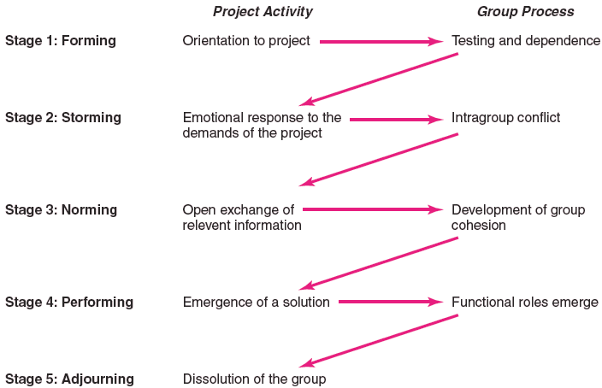
The Five-Stage Team Development Model
FIGURE 11.1

Slide 5
Conditions Favorable to the Development of High Performance Project Teams
Ten or fewer team members
Voluntary team membership
Continuous service on the team
Full-time assignment to the team
An organization culture of cooperation and trust
Members report only to the project manager
All relevant functional areas are represented on the team
The project has a compelling objective
Members are in speaking distance of each other

Slide 6
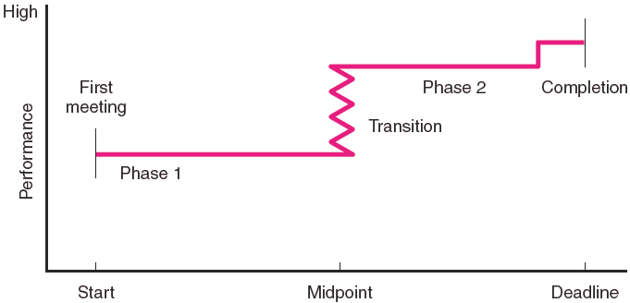
The Punctuated Equilibrium Model
of Group Development
FIGURE 11.2

Slide 7
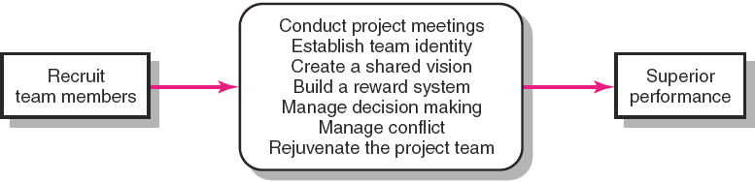
Creating a High-Performance Project Team
FIGURE 11.3

Slide 8

Building High-Performance Project Teams
Recruiting Project Members
  Factors affecting recruiting
    Importance of the project
    Management structure used to complete the project
  How to recruit?
    Ask for volunteers
  Who to recruit?
    Problem-solving ability
    Availability
    Technological expertise
    Credibility
    Political connections
    Ambition, initiative, and energy

Slide 9
Project Team Meetings
Managing
Subsequent Meetings
Establishing Ground Rules
Conducting Project Meetings
Relationship Decisions
Planning Decisions
Managing Change Decisions
Tracking Decisions

Slide 10

Establishing a Team Identity
Effective Use
of Meetings
Co-location of
team members
Creation of project
team name
Team rituals

Slide 11
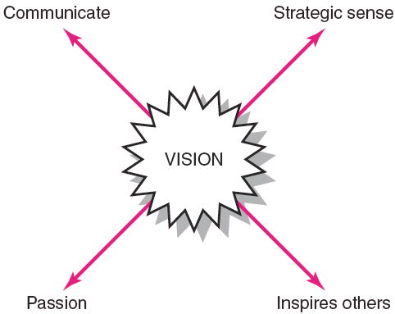
Requirements for an Effective Shared Vision
FIGURE 11.4

Slide 12
Managing Project Reward Systems
Group Rewards
  Who gets what as an individual reward?
  How to make the reward have lasting significance?
  How to recognize individual performance?
    Letters of commendation
    Public recognition for outstanding work
    Desirable job assignments
    Increased personal flexibility

Slide 13

Orchestrating the Decision-Making Process
Problem Identification
Generating Alternatives
Reaching a Decision
Follow-up

Slide 14
Managing Conflict within the Project Team
Encouraging Functional Conflict
  Encourage dissent by asking tough questions.
  Bring in people with different points of view.
  Designate someone to be a devil’s advocate.
  Ask the team to consider an unthinkable alternative
Managing Dysfunctional Conflict
  Mediate the conflict.
  Arbitrate the conflict.
  Control the conflict.
  Accept the conflict.
  Eliminate the conflict.

Slide 15
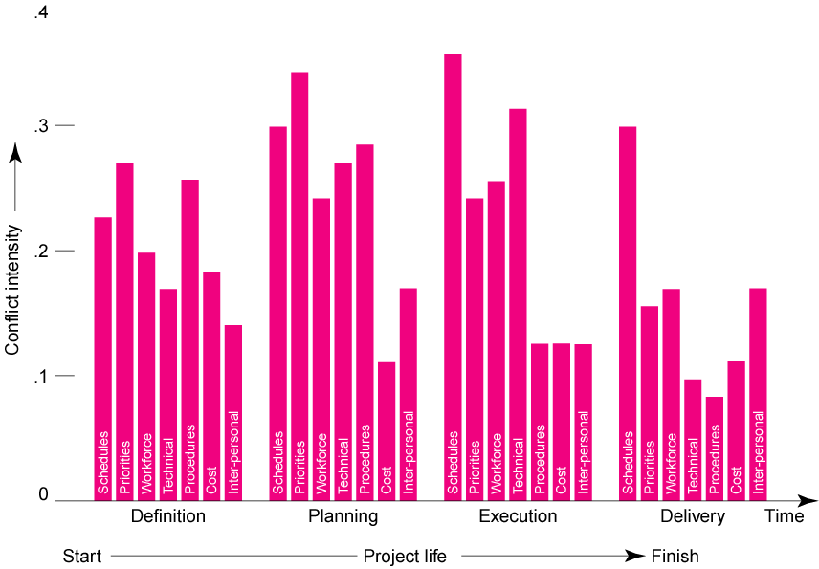
Conflict Intensity Over the Project Life Cycle
FIGURE 11.5

Slide 16
Rejuvenating the Project Team
Informal Techniques
  Institute new rituals.
  Take an off-site break as a team from the project.
  View an inspiration message or movie.
  Have the project sponsor give a pep talk.
Formal Techniques
  Hold a team building session facilitated by an outsider to clarify ownership issues affecting performance.
  Engage in an outside activity that provides an intense common experience to promote social development of the team.

Slide 17
Managing Virtual Project Teams
Challenges:
  Developing trust
    Exchange of social information.
    Set clear roles for each team member.
  Developing effective patterns of communication.
    Include face-to-face if at all possible.
    Keep team members informed on how the overall project is going.
    Don’t let team members vanish.
    Establish a code of conduct to avoid delays.
    Establish clear norms and protocols for surfacing assumptions and conflicts.

Slide 18
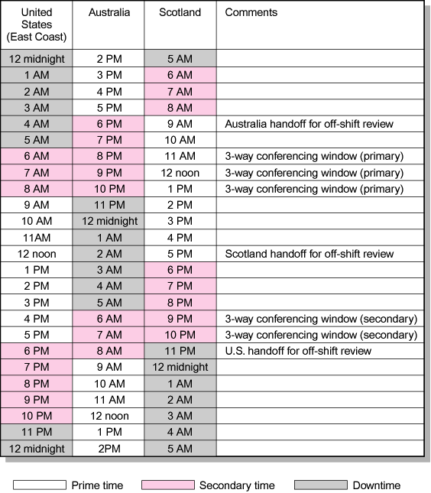
24-Hour Global Clock
FIGURE 11.6

Slide 19

Project Team Pitfalls
Groupthink
Bureaucratic
Bypass Syndrome
Going Native
Team Spirit Becomes
Team Infatuation

Slide 20
Key Terms
Brainstorming
Dysfunctional conflict
Functional conflict
Groupthink
Nominal group technique (NGT)
Positive synergy
Project kickoff meeting
Project vision
Team building
Team rituals
Virtual project team

